Slide 1
Beyond LAB – Scripting at scale
Evgenij Smirnov
Notes:
[REQUIRED SLIDE]

Slide 2
Notes:
[REQUIRED SLIDE]

Slide 3
Agenda
Leaving the Lab: Scale-Up and Scale-Out
Challenges we are certain to encounter
Problems that may lurk in the bushes
Assuming the performance-bound scripting posture
Warm-Up: Juggling data from file to memory and back again
Timing the results: Your Mileage May Vary
Demo scenario 1: Scaling up
Demo scenario 2: Scaling out
Wrap-Up

Slide 4
ABOUT THIS SESSION
No recipes for concrete tasks – follow the train of thought
Windows PowerShell only – for PS7 goodness or X-plat, go test!
True live demos would involve long waits so I timed them for you in advance
Most of the demo work is done on VMs, with restrictions we’ll talk about in a couple of minutes

Slide 5
Leaving the Lab: what is scale?
Scale up: Large data source, some known substructure (if we’re lucky)
Large databases / monolithic data files
Scale out: Many data sources of similar or identical nature
Server landscapes
IoT infrastructures
Large quantities of data files
In this talk, we’ll only be looking at gathering data
altering it is another story – maybe next year?

Slide 6
Scripting at scale: challenges
Script runs for ages → make it faster
Script maxes out CPU/RAM/Net/IO → throw more resources at it make it consume less resources
(Scale-Out) Targets are not always accessible
→ plan for interruption / make it more robust
Environment changes faster than data is gathered
→ plan for differentials / make it more consistent

Slide 7
SCRIPTING AT SCALE
Things you will have to keep in mind:
Where do which processes really run and how much resources do they demand?
How much data gets transferred over which network?
How much data needs to be stored for immediate processing?
How big is the expected result set and in what form is it expected?

Slide 8
SCRIPTING AT SCALE: Approaching optimization
Gauge the performance of known approaches on a small subset
Optimize the data acquisition technology
Use any knowledge about internal structure of the data sources
Keep an eye on the resource usage

Slide 9

SCRIPTING AT SCALE: RULES OF ENGAGEMENT
Concentrate on the task at hand don’t reinvent the wheel because the existing wheel wasn’t good enough
No holds barred ugly is OK if it’s efficient
Do not disrupt
they won’t be impressed by that report if the whole system is down

Slide 10
Warm-Up: Writing results to file

Slide 11
#00-01-Write-File
$arr = New-Object System.Collections.ArrayList $NumberOfLines = 1000000 # One million entries for($i = 1; $i -lt $NumberOfLines; $i++) { $null = $arr.Add($i.ToString().PadLeft(16,"0")) }
$arr | Out-File "C:\temp\file1.txt" -Encoding UTF8
$arr | Set-Content "C:\temp\file2.txt"
$sw = New-Object System.IO.StreamWriter("C:\temp\file3.txt”, [System.Text.Encoding]::UTF8) $arr.ForEach({ $sw.WriteLine($_) }) $sw.Close()
[System.IO.File]::WriteAllLines("C:\temp\file4.txt",$arr,[System.Text.Encoding]::UTF8)
6 sec
57 sec
24 sec
7.7 sec
0.5 sec
Notes:
On a non-constrained VM. Half of that time on metal!

Slide 12
Times and numbers: YMMV
You can easily get very different execution times in your environment
Methodology applied here only ensures that:
None of the systems was constrained, compute- or I/O-wise, unless I say so
If caching could affect subsequent measurements, systems were rebooted
All operations ran at least twice as fast on a laptop as in a VM.
Be aware of foreground vs. background processing!
Here’s hoping that the relative results will reflect your experience ☺

Slide 13
Reading ‘em back

Slide 14
#00-02-Read-File
$arr = Get-Content "C:\temp\file.txt"
$arr = New-Object System.Collections.ArrayList $of = New-Object System.IO.StreamReader("C:\temp\file.txt”) while ($of.Peek() –gt 0) { $arr.Add( $of.ReadLine() ) } $of.Close()
$arr = [System.IO.File]::ReadAllLines("C:\temp\file.txt")
30 sec
7.5 sec
0.95 sec
Notes:
On a non-constrained VM. Half of that time on metal!

Slide 15

Looking for patterns in files
For a “tell me if any matches are found in those files” type of problem, I wasn’t able to find anything nearly as fast as
Select-String -Path $files –Pattern $regexes -Quiet
For a “tell me if a certain pattern is found in one of those files” kind, direct regex checking each line in a loop can be faster (if a match is found early). If a match is found late, it’s going to be slightly slower.
NB: Select-String taking input from the pipe or InputObject or outputting the matches is NOT faster than the alternatives!

Slide 16

Scaling up: Active Directory

Slide 17

THE CHALLENGE
IF YOU COULD JUST GO AHEAD
AND EXPORT ALL OUR LOGIN NAMES,
THAT’D BE GREAT…

Slide 18
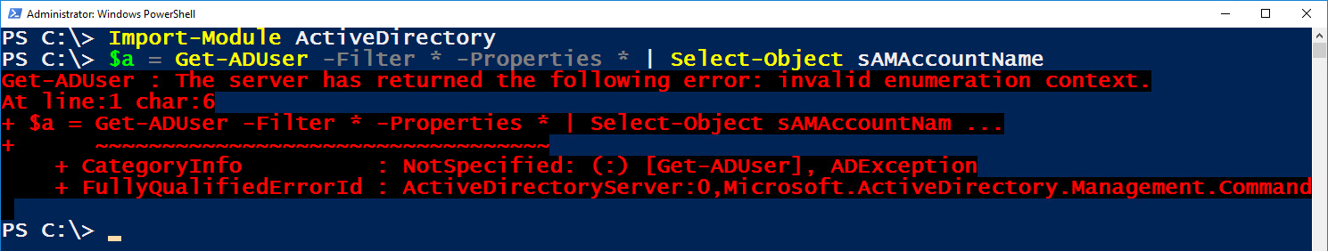
NOT A PROBLEM, RIGHT?
Hold my beer…
Get-ADUser -Filter * -Properties * | Select-Object sAMAccountName
…for 30 minutes…
FAIL

Slide 19
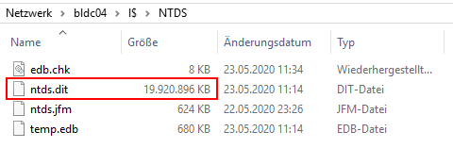
SETUP IN THIS DEMO
A single domain AD forest
Four domain controllers, virtualised (vSphere) but not constrained
Enough RAM assigned to each DC to serve NTDS.DIT from memory
…which is a lot of RAM
There are 1.5 Million user objects, as well as some 800,000 computers, groups etc. in this AD…

Slide 20
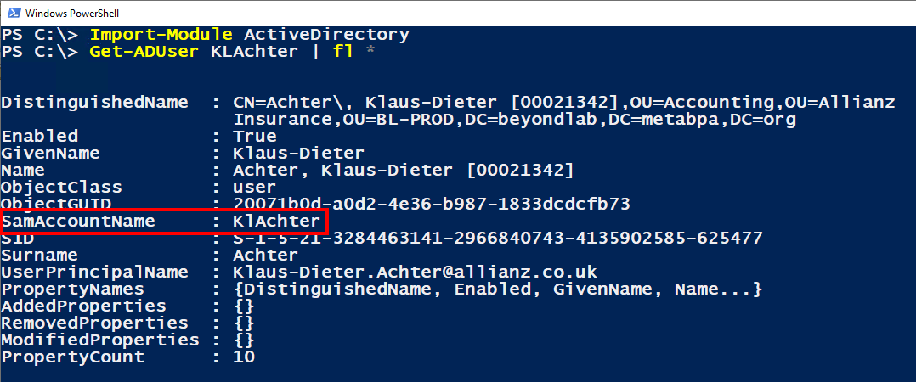
OPTIMIZING DATA ACQUISITION
Get-ADUser is OK but pulls too much data (for the task at hand)

Slide 21
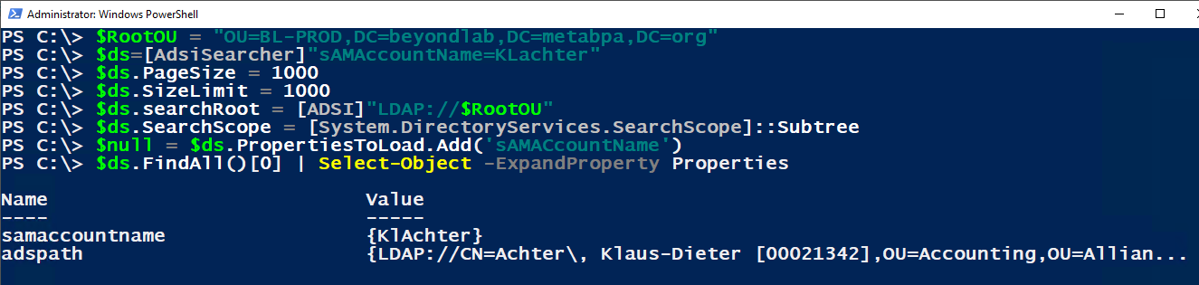
OPTIMIZING DATA ACQUISITION – cont’d
ADSISearcher delivers only the data we’re looking for and avoids the middleware (ADWS) at the same time:

Slide 22
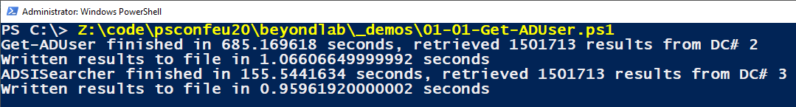
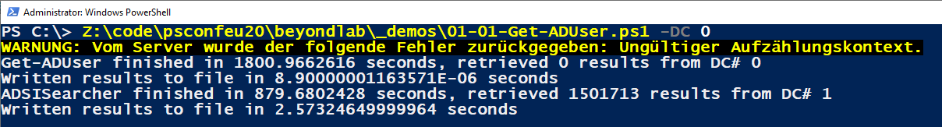
OPTIMIZING data acquisition - results
 | Get-ADUser | ADSISearcher
1 Gbps between workstation and DCs | 685 sec | 156 sec
10 Mbps between workstation and DCs | 1801 sec (30 minutes) ADWS broke down | 880 sec (5.6x)

Slide 23
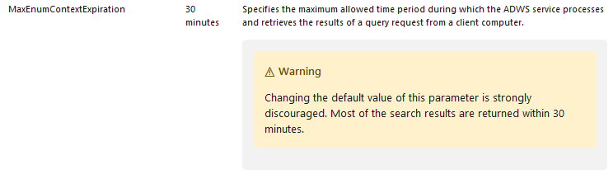
AN ASIDE ON ADWS
ADWS is not all bad, but it’s got some configuration maximums that are not suitable for scale-up deployments.
You can change those in Microsoft.ActiveDirectory.WebServices.exe.config as documented in https://docs.microsoft.com/en-us/previous-versions/windows/it-pro/windows-server-2008-R2-and-2008/dd391908(v=ws.10)

Slide 24
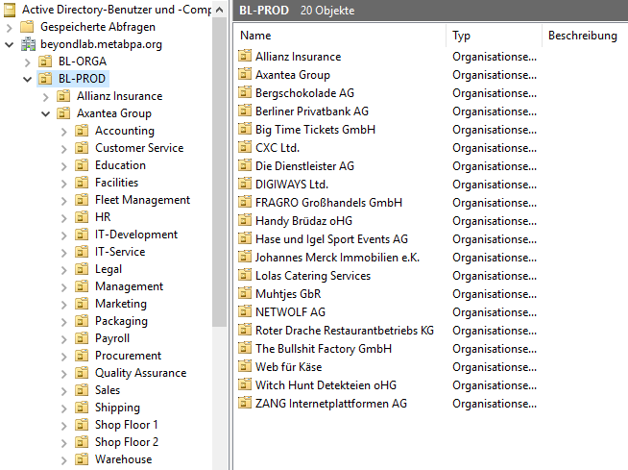
USING KNOWLEDGE ABOUT INTERNAL STRUCTURE
There are 20 Sub-OUs containing user (and other) objects…
All this data is present on all 4 domain controllers…
Let’s do it in parallel ☺

Slide 25
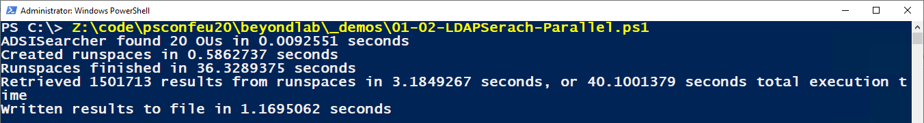
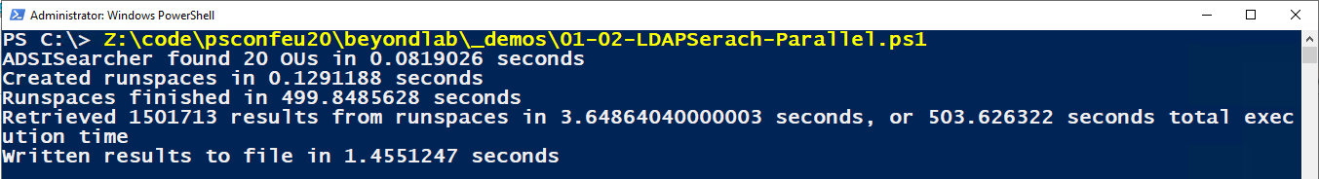
Using knowledge about internal structure – cont’d
We’ve gone from 12 minutes to 40 seconds for 1.5 million results over fast network but only to 500 (from 880) seconds over slow network…

Slide 26
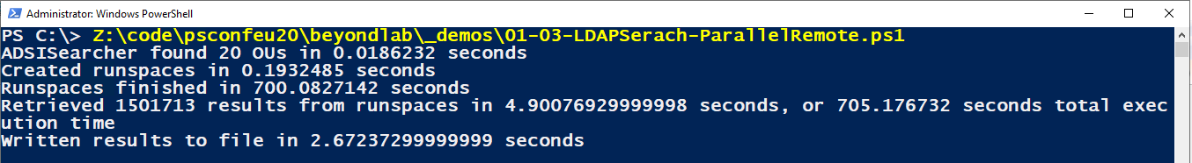
USING KNOWLEDGE ABOUT INTERNAL STRUCTURE – CONT’D
Offloading data retrieval to DCs themselves does not speed up the overall process.
Now if we had a machine on the DCs network ;-)

Slide 27
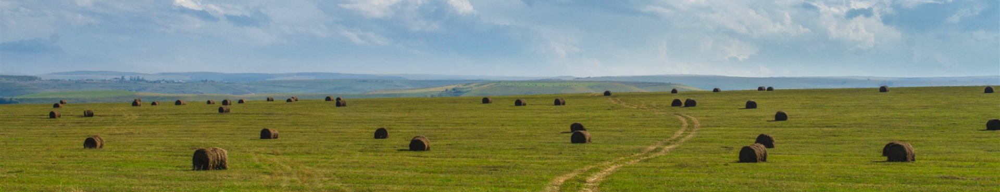
Scaling out: Analyzing IIS logs

Slide 28
SETUP IN THIS DEMO
50x Server 2016 IIS servers, all serving the same set of web apps
Servers are CPU- and Disk-I/O-, but not RAM-constrained
We can adjust the network speed between our workstation and the servers (think cloud ;-) )
All servers have been running for ~3 years so each one is carrying ~1000 log files, about 11 MB each.

Slide 29
THE LIKELY OBJECTIVES
Which of the IP addresses 141.20.1.3, 88.22.37.43, 160.83.8.29 and 105.44.31.26 have accessed the website at all?
Which of the IP addresses 141.20.1.3, 88.22.37.43, 160.83.8.29 and 105.44.31.26 have accessed the /admin vDir?
How many times has the file /img/kate-unedited.jpg been accessed?
…

Slide 30
ANALYZING THE OBJECTIVE
Which of the IP addresses 141.20.1.3, 88.22.37.43, 160.83.8.29 and 105.44.31.26 have accessed the website at all?
Technically, it is a simple pattern-matching exercise.
There is no knowing which log(s) on which node(s) may or may not contain the pattern.
Best case: All patterns are contained within the first log (=every log) on the first node we scan (=every node) → can stop scanning as soon as all patterns have been found.
Worst case: Patterns are not contained in any log on any node → have to scan every single file.

Slide 31
GETTING THE LAY OF THE LAND
When starting out on a new at-scale scripting adventure, write some snippets to get the comms right and to gauge the overall performance.
Let’s start by counting and measuring all the files…

Slide 32
# 02-01-Measure-Files-PS $drv = "C" $pth = "inetpub\logs\LogFiles“ $nfiles = 0 $szfiles = 0 $computers.ForEach({ $path = ('\\{0}\{1}$\{2}' -f $_,$drv,$pth) $files = Get-ChildItem $path | Measure-Object -Property Length –Sum $nfiles += $files.Count $szfiles += ($files.Sum / 1MB) }) # …or the same in parallel? $nfiles = 0 $szfiles = 0 (Invoke-Command -ComputerName $computers -ScriptBlock { $path = ('{0}:\{1}' -f $using:drv,$using:pth); Get-ChildItem $path | Measure-Object -Property Length -Sum }).ForEach({ $nfiles += $_.Count; $szfiles += ($_.Sum / 1MB) })

Slide 33
# 02-02-Measure-Files-Native $nfiles = 0 $szfiles = 0 $computers.ForEach({ $path = ('\\{0}\{1}$\{2}' -f $_,$drv,$pth) $dir = [System.IO.DirectoryInfo]::new($path) $dir.GetFileSystemInfos().Foreach({ $szfiles += ($_.Length / 1MB) $nfiles++ }) })
# …or the same in parallel?
# …or the same remotely?

Slide 34
The RESULTS
 | PS sequential | .NET sequential | PS parallel | .NET parallel | PS remote | .NET remote
1 Gbps link | 7.2 sec | 2.25 sec | 2.1 sec | 0.87 sec | 35 sec | 26 sec
10 Mbps link | 30 sec | 12 sec | 17 sec | 8.4 sec | 40 sec | 44 sec
Unsurprisingly, network speed has very little effect on remote execution but affects local execution with share access rather dramatically.
.NET methods are about 3x faster when ran on one workstation only

Slide 35

SEARCHING THE DATA
The amount of data in the answers we’re looking for is negligible.
To get those answers, however, we need to sift through (worst case) 500+ GB of files, maybe even (catastrophic case) several times.
No way we’re transporting this kind of data over the network!
Plan of action:
do the analysis remotely on the webservers
keep an eye on the local resource usage
evaluate early breakout possibilities

Slide 36
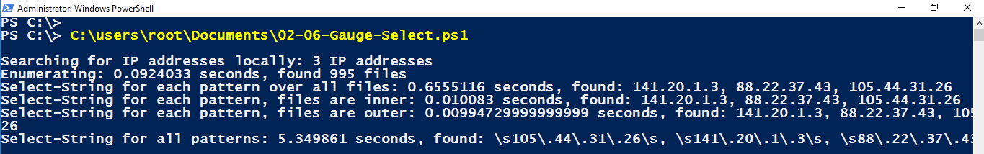
GAUGING THE MATCHING
Local execution, all matches are found early:
In optimal cases looping through patterns, or even files, is OK because of early breakout.
In bad cases, looping through patterns should be avoided at any price!

Slide 37
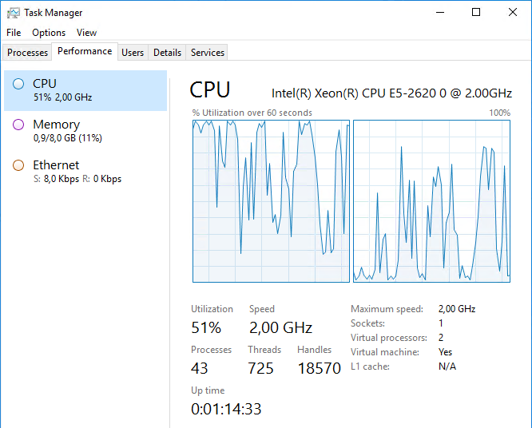
GAUGING THE PERFORMANCE OF REMOTE EXECUTION
One target, completely unconstrained.
In the worst case scenario, we’ve been running for 18 minutes, consuming 50% CPU on the target machine
Select-String | 1x IP | 3xIP | 1x IP n/p
1x machine | 6 sec | 6 sec | 1,060 sec
3x machines | 6 sec | 6.5 sec | 1,140 sec
First file/line | 1x IP | 3xIP | 1x IP n/p
1x machine | 7 / 6 sec | 9.5 / 6 sec | 1240 / 1201
3x machines | 7 / 6 sec | 10 / 6.5 sec | 1320 / 1290

Slide 38
Execution time Optimization + early breakout
Select-String -Quiet does early breakout all by itself!
If first match of any pattern is enough, it doesn’t get faster than that.
Looped variations can be optimized
Early breakout only works if you have control over the loop
Early breakout won’t work (globally) with Invoke-Command –ComputerName $array
→ We need to do our own parallelism and just discard runspaces as soon as we gathered enough results → sample code

Slide 39
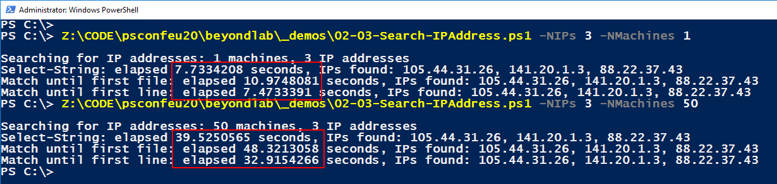
EXECUTION IN A CPU-CONSTRAINED SCENARIO
Best case (all patterns are found many times in every file): execution time is longer by 5x, and the farm is under load for < 1min
Worst case (one or more patterns is not found at all): execution time is longer by 20x, and the farm is under load for hours

Slide 40
Resource usage optimization
Monolithic calls like Select-String cannot be optimized.
In looped calls, inserting pauses (Start-Sleep) can help return CPU to other processes. However, it only makes sense in loops with many short cycles (i.e. looping through lines of file vs. looping through entire files).
It is also possible to set the priority of wsmprovhost.exe to “below normal” at the beginning of the remote execution:
$ph = Get-WMIObject -Class Win32_Process -Filter "Name='wsmprovhost.exe'" | Select-Object -ExpandProperty Handle
([WMI]"Win32_Process.Handle=$ph").SetPriority(64)
But do reset it to normal afterwards!

Slide 41

What if there are CHAOS MONKEYS?
There are two problems with Chaos Monkeys (a.k.a. patch managers) in connection with long-running scripts:
Machines are not up when you start querying
Machines go down while you are still querying

Slide 42
DAILY BUSINESS – running scripts on a regular basis
Use differential queries – even if it won’t always save time, it certainly saves cycles.
In monolithic sources like AD, whenChanged time stamp or USN can be used
In our IIS logs exercise, there’s no need to requery for entries that have already been found
Store previous results in a fast and reliable manner (e.g. SQL database) and use them as baseline for daily execution.

Slide 43
Summary
Concentrate on the task at hand
plan for early breakout
but think one step ahead
and be prepared to end up with some ugly code
Experiment in advance, get to know your systems
Plan for interruption – chaos monkeys never sleep
Use differentials for repeated queries
… even you can have some really dumb artifacts in your scripts ;-)
Watch out for VMs, particularly server VMs, for foreground tasks!
… and for all that’s holy, STOP USING ARRAYS!

Slide 44
Notes:
[REQUIRED SLIDE]

Slide 45

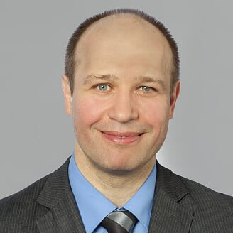
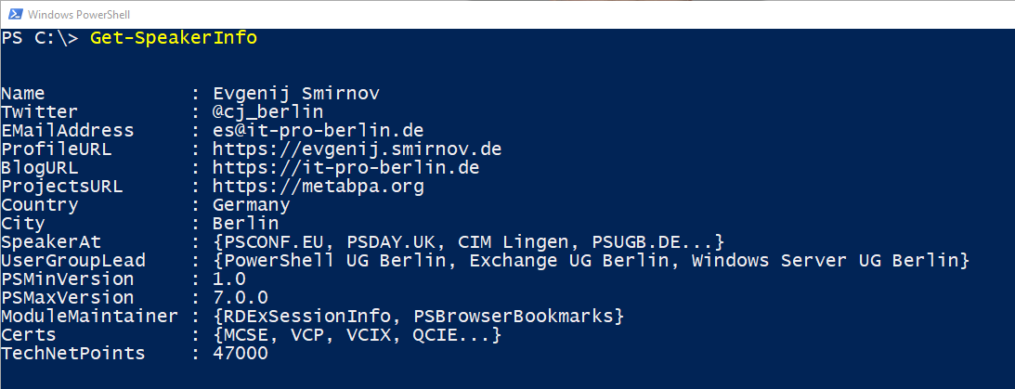
about_Speaker
Notes:
[REQUIRED SLIDE]

Slide 46

Delegate sign-up opens November 2020 at https://psconf.eu
Notes:
[REQUIRED SLIDE]

